Slide 1

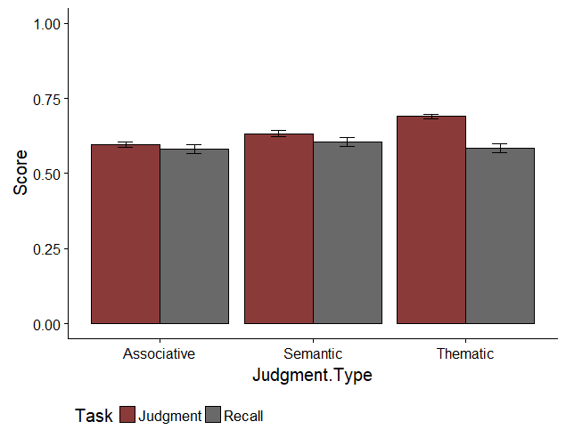
Modeling Memory: Exploring the Interaction Between Associative, Thematic, and Semantic Overlap
When Predicting Judgments and Recall
Nicholas P. Maxwell & Erin M. Buchanan, Missouri State University
Abstract
Previous work conducted on judgments of associative memory (JAM) has shown these judgments to be highly stable and that they generalize well across different contexts (Maki, 2007a; Maki, 2007b; Valentine and Buchanan, 2013). In a pilot study, the JAM paradigm was expanded to include semantic and thematic judgments, and found that judgment and recall could be predicted by the three way interaction between the network norms. The present study seeks to replicate these interaction findings while controlling for several types of single word norms. Additionally, this study seeks to explore which single word norms are the strongest predictors of judgment and recall ability.
Results
Judgment – Final Model
Mean Judgment and Recall Scores
Predictor | β (SE) | t | p
SUBTLEX 1 | .023 (.006) | 3.990 | < .001
SUBTLEX 2 | -.019 (.006) | -3.212 | .001
Length 1 | -0.020 (.002) | -8.094 | < .001
Length 2 | -.002 (.002) | -.958 | .338
AOA 1 | .016 (.002) | 7.662 | < .001
AOA 2 | -.013 (.002) | -4.749 | < .001
Familiarity 1 | .085 (.014) | 6.082 | < .001
Familiarity 2 | -.094 (.012) | -7.916 | < .001
Valence 1 | .005 (.002) | 2.076 | .038
Valence 2 | -.017 (.002) | -7.813 | < .001
Imageability 1 | .034 (.005) | 6.289 | < .001
Imageability 2 | -.070 (.005) | -12.803 | < .001
Concreteness 1 | -.008 (.004) | -2.218 | .027
Concreteness 2 | .035 (.005) | 7.649 | < .001
QSS | .004 (.001) | 6.775 | < .001
TSS | -.001 (.001) | -1.407 | .160
FSS 1 | -.001 (.001) | -5.278 | < .001
FSS 2 | .001 (.001) | .419 | .675
Ortho N 2 | .001 (.001) | 2.837 | .005
Phono N 1 | -.001 (.001) | -5.975 | < .001
FSG | .391 (.021) | 18.186 | < .001
LSA | .123 (.015) | 7.919 | < .001
COS | .027 (.011) | 2.429 | .015
FSG:LSA:COS | .558 (.338) | 1.648 | .099
Method
Participants
221 participants were recruited from Amazon’s Mechanical Turk.
Stimuli
63 word pairs of varying associative, semantic, and thematic relatedness were created from the Buchanan et al. (2013) word norm database. Forward Strength (FSG) was used to measure association, semantic overlap was measured with Cosine (COS), and thematic relations were measured with Latent Semantic Analysis (LSA).
Single word norms were grouped into three classes: Lexical information (i.e., word length, POS, morphemes, syllables), neighborhood connections (i.e., orthographic and phonographic neighborhoods), and rated properties (i.e., age of acquisition, familiarity, valence).
Procedure
First, participants were presented with word pairs and were ask to judge how related they believed each word pair to be based on its associative, semantic, or thematic relatedness. This section was divided into three blocks, with each block beginning with a set of instructions explaining the type of relationship to be judged. Judgments were made on a scale of zero to 100, with zero indicating no relationship between items. Each block focused on one of the three types of judgments, and the order of instructions and judgment blocks was counterbalanced, resulting in each word-pair receiving judgments for each of the three types of relationships. Participants then completed a short distractor task before moving on to a cued recall task. Data was then combined with results from the pilot study, leading to 333 participants making judgments across 126 stimuli pairs.
Analysis
Maximum likelihood multilevel modeling was used to test the interaction between FSG, COS, and LSA when predicting participant judgments and recall while controlling for type of judgment. These models were chosen because they retain all data points and control for error correlations between participants. When analyzing recall, a logistic regression was incorporated into the model to account for the binary nature of recall.
Single word norms were entered into the models in a series of steps. The first model used lexical information as the IVs. Model 2 added rated properties, Model 3 added in neighborhood connections, and Model 4 added in the original network norms.
Stepwise regression modeling was used to select which predictors were used at each step of the model.
Note: Judgment scores have been divided by 100 so as to place them on the same scale as recall.
Recall – Final Model
Predictor | β (SE) | z | p
SUBTLEX 1 | -.346 (.054) | -6.419 | < .001
SUBTLEX 2 | .008 (.054) | .141 | .888
Length 1 | .198 (.025) | 7.815 | <. 001
Length 2 | -.104 (.023) | -4.590 | <. 001
AOA 1 | -.080 (.020) | -4.093 | < .001
AOA 2 | .033 (.025) | 1.299 | .194
Familiarity 1 | -.415 (.129) | -3.230 | .001
Familiarity 2 | -.163 (.109) | -1.498 | .134
Valence 1 | -.152 (.021) | -7.180 | < .001
Valence 2 | .056 (.022) | 2.542 | .011
Imageability 1 | .052 (.036) | 1.429 | .153
Concreteness 2 | -.204 (.030) | -6.733 | < .001
QSS | .003 (.004) | .925 | .355
TSS | -.003 (.005) | -.647 | .518
FSS 1 | -.008 (.002) | -3.418 | .001
FSS 2 | .009 (.002) | 4.259 | < .001
Ortho N 1 | -.001 (.006) | -.187 | .852
Ortho N 2 | -.007 (.005) | -1.436 | .151
Phono N 1 | .001 (.002) | .548 | .584
Phono N 2 | -.006 (.002) | -2.662 | .008
FSG | 1.866 (.210) | 8.880 | < .001
LSA | .687 (.146) | 4.710 | < .001
COS | .277 (.102) | 2.713 | .007
FSG:LSA:COS | -8.808 (3.161) | -2.786 | .005
Note: FSG, COS, and LSA were mean centered. 1 = Cue item, 2 = Target Item
Summary and Discussion
Overall, Recall was predicted by the three-way interaction of semantic, thematic, and associative word-pair norms. Consistent with previous findings, Forward Strength was the strongest predictor for each DV.
Cue familiarity, concreteness, and frequency were each strong negative predictors of recall ability. While initially these results seem counter intuitive, unfamiliar and less frequently used words may be less prone to interference, and thus easier to recall.
Familiarity of cue and target item were the strongest predictors of judgment ratings. Generally, the more familiar participants were with the cue item, the higher they rated the relationship. Familiarity with the target item was found to have the inverse effect.
Contact: Nicholas Maxwell (maxwell270@live.missouristate.edu)
R code available at: https://osf.io/j7qtc//

